Slide 1


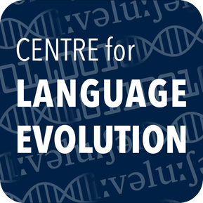

Systemic structure of kinship is shaped by evolutionary processes
Maisy Hallam, Fiona Jordan,
Simon Kirby & Kenny Smith

Slide 2

Questions
are there cross-linguistic patterns in how kin are categorised together?
Maisy Hallam ・ Centre for Language Evolution・EvoLang 2024
Notes:
Two questions: the first, in the world’s languages are there structural regularities in how family members tend to be grouped.

Slide 3
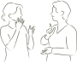

Questions
are there cross-linguistic patterns in how kin are categorised together?
...and how do we as individuals determine which kin should be categorised together?
Maisy Hallam ・ Centre for Language Evolution・EvoLang 2024
Notes:
And if so, how do we as individuals determine those regularities? How did kinship evolve to be this way?

Slide 4

Kinship terminology is a category system
used to group together and distinguish different relatives.
Maisy Hallam ・ Centre for Language Evolution・EvoLang 2024
Notes:
What do I mean by kinship terms, kinship categories, kinship systems? imagine you're taking a photograph of your family at some kind of holiday event. As an English speaker, you’d probably distinguish your relationships with these people in a number of ways.

Slide 5

father
mother
Kinship terminology is a category system
used to group together and distinguish different relatives.
Maisy Hallam ・ Centre for Language Evolution・EvoLang 2024
Notes:
You have a mother and a father – your parents, distinguished by gender.

Slide 6
uncle
father
uncle
aunt
mother
Kinship terminology is a category system
used to group together and distinguish different relatives.
Maisy Hallam ・ Centre for Language Evolution・EvoLang 2024
Notes:
And you might have a couple of uncles and an aunt, your parents’ siblings, categorised on the basis of gender.

Slide 7
uncle
cousin
father
uncle
aunt
mother
sister
cousin
Kinship terminology is a category system
used to group together and distinguish different relatives.
Maisy Hallam ・ Centre for Language Evolution・EvoLang 2024
Notes:
And you might have a couple of cousins, your parents’ siblings kids, who are distinct from your own sister.

Slide 8
makuakane
makuakane
kaikua’ana
makuakane
makuahine
makuahine
kaikuahine
kaikuahine
The relatives that belong in each category vary cross-linguistically.
Maisy Hallam ・ Centre for Language Evolution・EvoLang 2024
Notes:
Same group of people but now only four categories to distinguish them

Slide 9
The world’s kinship classification systems achieve an optimal trade-off between simplicity and informativeness.
Kemp & Regier, 2012
Maisy Hallam ・ Centre for Language Evolution・EvoLang 2024
Notes:
Although there’s a substantial amount of variation in how kin are categorised across the world’s languages, previous work has shown that that variation is highly constrained. It optimally balances simplicity and expressivity.

Slide 10
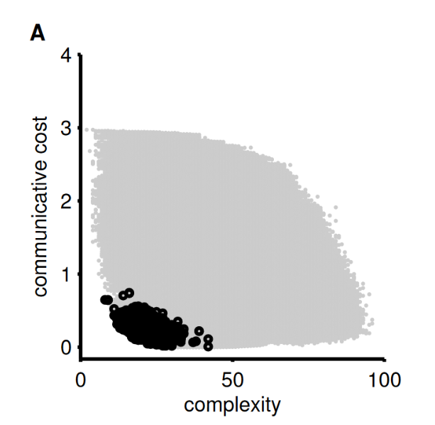

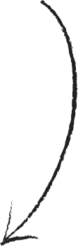
possible
kinship systems
kinship systems
that really exist
The world’s kinship classification systems achieve an optimal trade-off between simplicity and informativeness.
Kemp & Regier, 2012
Maisy Hallam ・ Centre for Language Evolution・EvoLang 2024
Notes:
This finding from kemp and regier shows that of all the theoretically possible ways to categorise kin, these grey dots, only the black dots are actually attested.
These black dots are kinship systems that are as simple as possible given how much they express about family relationships, and as expressive as possible given how simple they are.
But what does this mean for kinship in practice. What does a simple kinship system look like? What typological regularities are inherent to this pareto frontier?

Slide 11
“changes in systems of kinship terminology involve linked sets of changes in related parts of the system.”
Passmore et al 2021
Maisy Hallam ・ Centre for Language Evolution・EvoLang 2024
Notes:
Passmore and colleagues offer a hypothesis about how kinship systems are constrained as a product of their evolution.
the evolutionary process of kinship facilitates predictability between pairs of relatives. i.e. terms want to be definable with reference to other terms
so when we get changes in one part of the tree, parallel changes occur so that the specificity of terms matches across the tree

Slide 12





uncle
father
cousin
brother
you
“changes in systems of kinship terminology involve linked sets of changes in related parts of the system.”
Passmore et al 2021
Maisy Hallam ・ Centre for Language Evolution・EvoLang 2024
Notes:
A system like English is quite predictable. You have a father, and his brother, your uncle. Your father’s son is called your brother. Your uncle’s son is called your cousin.

Slide 13

funcle
funcle
cousin
brother
you
“changes in systems of kinship terminology involve linked sets of changes in related parts of the system”
Passmore et al 2021
Maisy Hallam ・ Centre for Language Evolution・EvoLang 2024
Notes:
But imagine this system changes over time. Father and uncle merge to a single category, uncle.

Slide 14

???
funcle
funcle
cousin
brother
you
“changes in systems of kinship terminology involve linked sets of changes in related parts of the system”
Passmore et al 2021
Maisy Hallam ・ Centre for Language Evolution・EvoLang 2024
Notes:
You might be a little confused, because your system isn’t predictable anymore. Sometimes, the child of a funcle is a brother, and sometimes the child of a funcle is a cousin. You have no way to determine how these people are related to you on the basis of their categories alone.

Slide 15
funcle
funcle
brother
brother
you
“changes in systems of kinship terminology involve linked sets of changes in related parts of the system”
Passmore et al 2021
Maisy Hallam ・ Centre for Language Evolution・EvoLang 2024
Notes:
Under the Passmore hypothesis we should now get a parallel change, where the terms for cousin and brother merge into a single category. You can sleep well knowing that the child of a funcle is always a brother, and that your kinship system has predictable categories.

Slide 16

uncle
father
funcle
funcle
funcle
funcle
cousin
brother
you
brother
brother
you
cousin
brother
you
So kinship systems with predictive structure should be common cross-linguistically.
Maisy Hallam ・ Centre for Language Evolution・EvoLang 2024
Notes:
So, given that we expect linked sets of changes that facilitate predictive structure, we should expect kinship systems cross-linguistically to reflect this. A system where the child of a father is a brother and the child of an uncle is a cousin would be expected.

Slide 17
uncle
father
funcle
funcle
funcle
funcle
cousin
brother
you
brother
brother
you
cousin
brother
you
So kinship systems with predictive structure should be common cross-linguistically.
Maisy Hallam ・ Centre for Language Evolution・EvoLang 2024
Notes:
So would a system where the child of a funcle is a brother.

Slide 18

uncle
father
funcle
funcle
funcle
funcle
cousin
brother
you
brother
brother
you
cousin
brother
you
So kinship systems with predictive structure should be common cross-linguistically.
Maisy Hallam ・ Centre for Language Evolution・EvoLang 2024
Notes:
But not the intermediate system, which isn’t predictable. According to P’s hypothesis, we should generally see kinship systems with this parent-child predictive structure if we look at kinship systems cross-linguistically.

Slide 19
Is predictive structure a universal feature of kinship?
Maisy Hallam ・ Centre for Language Evolution・EvoLang 2024
Notes:
So, I ask whether this kind of predictive structure is a universal feature of kinship.

Slide 20

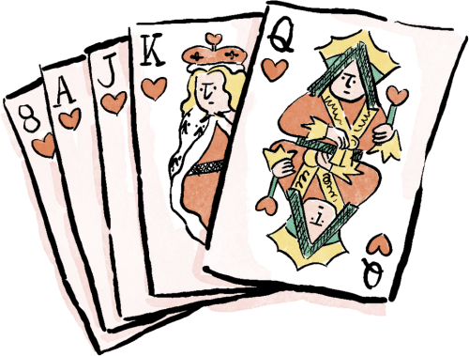
vs.
Data from KinBank :
kinship terms for 544 languages
including parents, nuncles, siblings and cousins
Simulated kinship data:
random permutations of
existing kinship systems
*
*Passmore, S. et al. (2023). Kinbank: A global database of kinship terminology. PLOS ONE, 18(5)
Maisy Hallam ・ Centre for Language Evolution・EvoLang 2024
Notes:
To do this, I did a typological study comparing natural languages to simulated baselines. Our natural language data comes from kinbank a database of kinship terminology, looking at terms for parents, aunts and uncles, siblings and cousins. and for each of those languages, we created 1000 simulated counterparts by randomly shuffling which terms were associated with which family members. This effectively creates a baseline of chance, breaking any predictive bonds between the two generations.

Slide 21
Natural languages will have more predictive structure than chance.
Maisy Hallam ・ Centre for Language Evolution・EvoLang 2024
Notes:
My expectation here is that by comparing these, we should see that natural languages have more predictive structure than the simulated baselines, indicating a selective pressure for predictive structure.

Slide 22
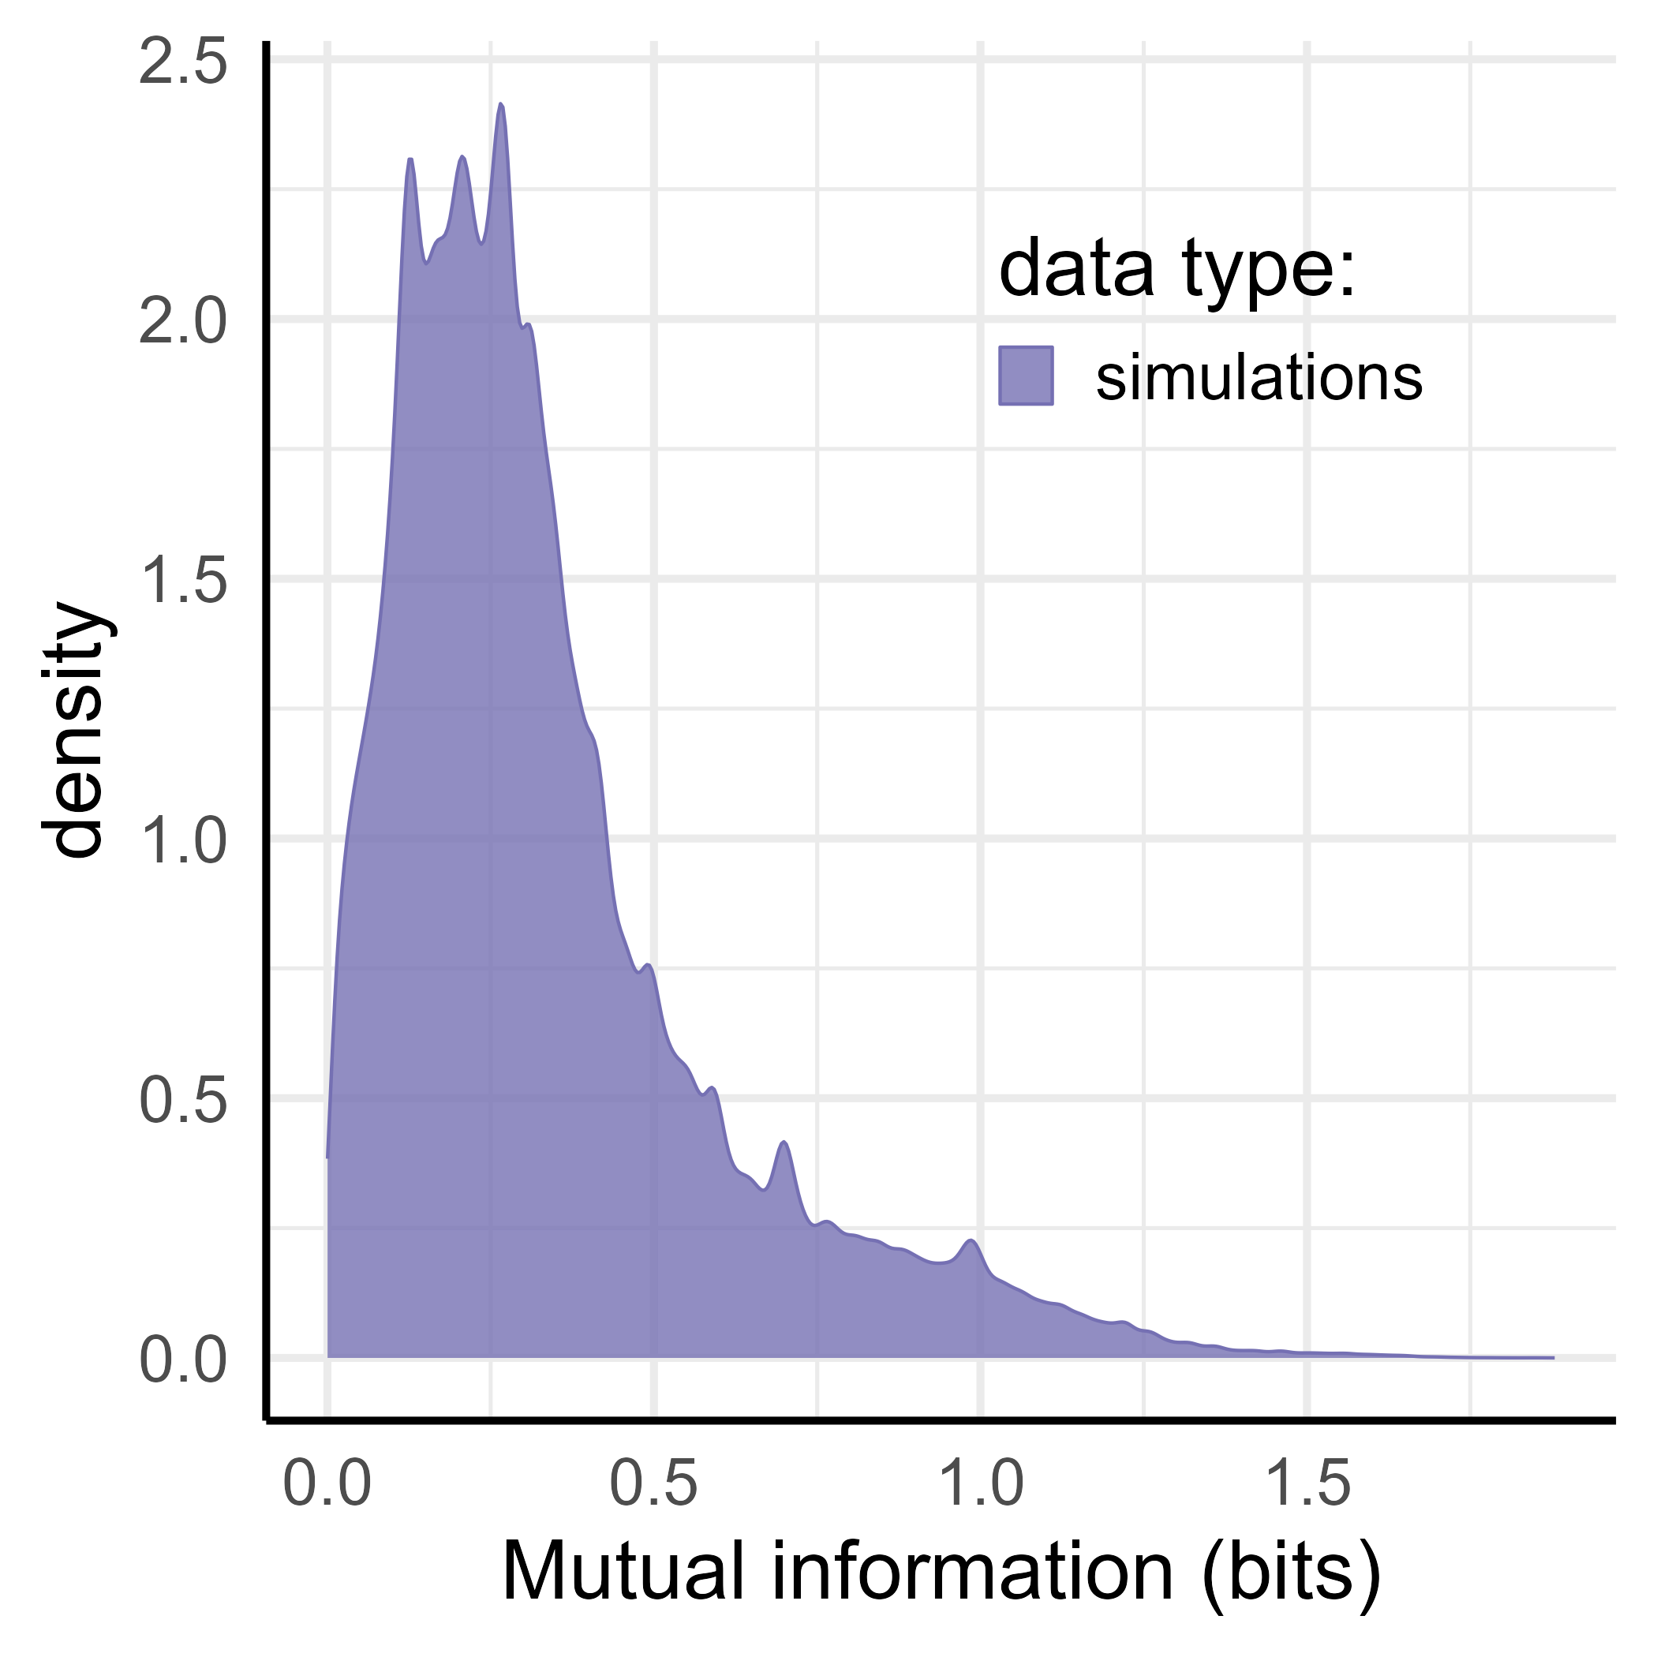
Natural languages will have more predictive structure than chance.
low
predictive structure
high
predictive structure
Maisy Hallam ・ Centre for Language Evolution・EvoLang 2024
Notes:
We measure predictive structure as mutual information, an information theoretic measure that basically tells us how much information we gain about one variable by observing another. So for example, how much information we gain about who an ‘uncle’ is by observing the term ‘cousin’. More MI, more predictive structure.

Slide 23
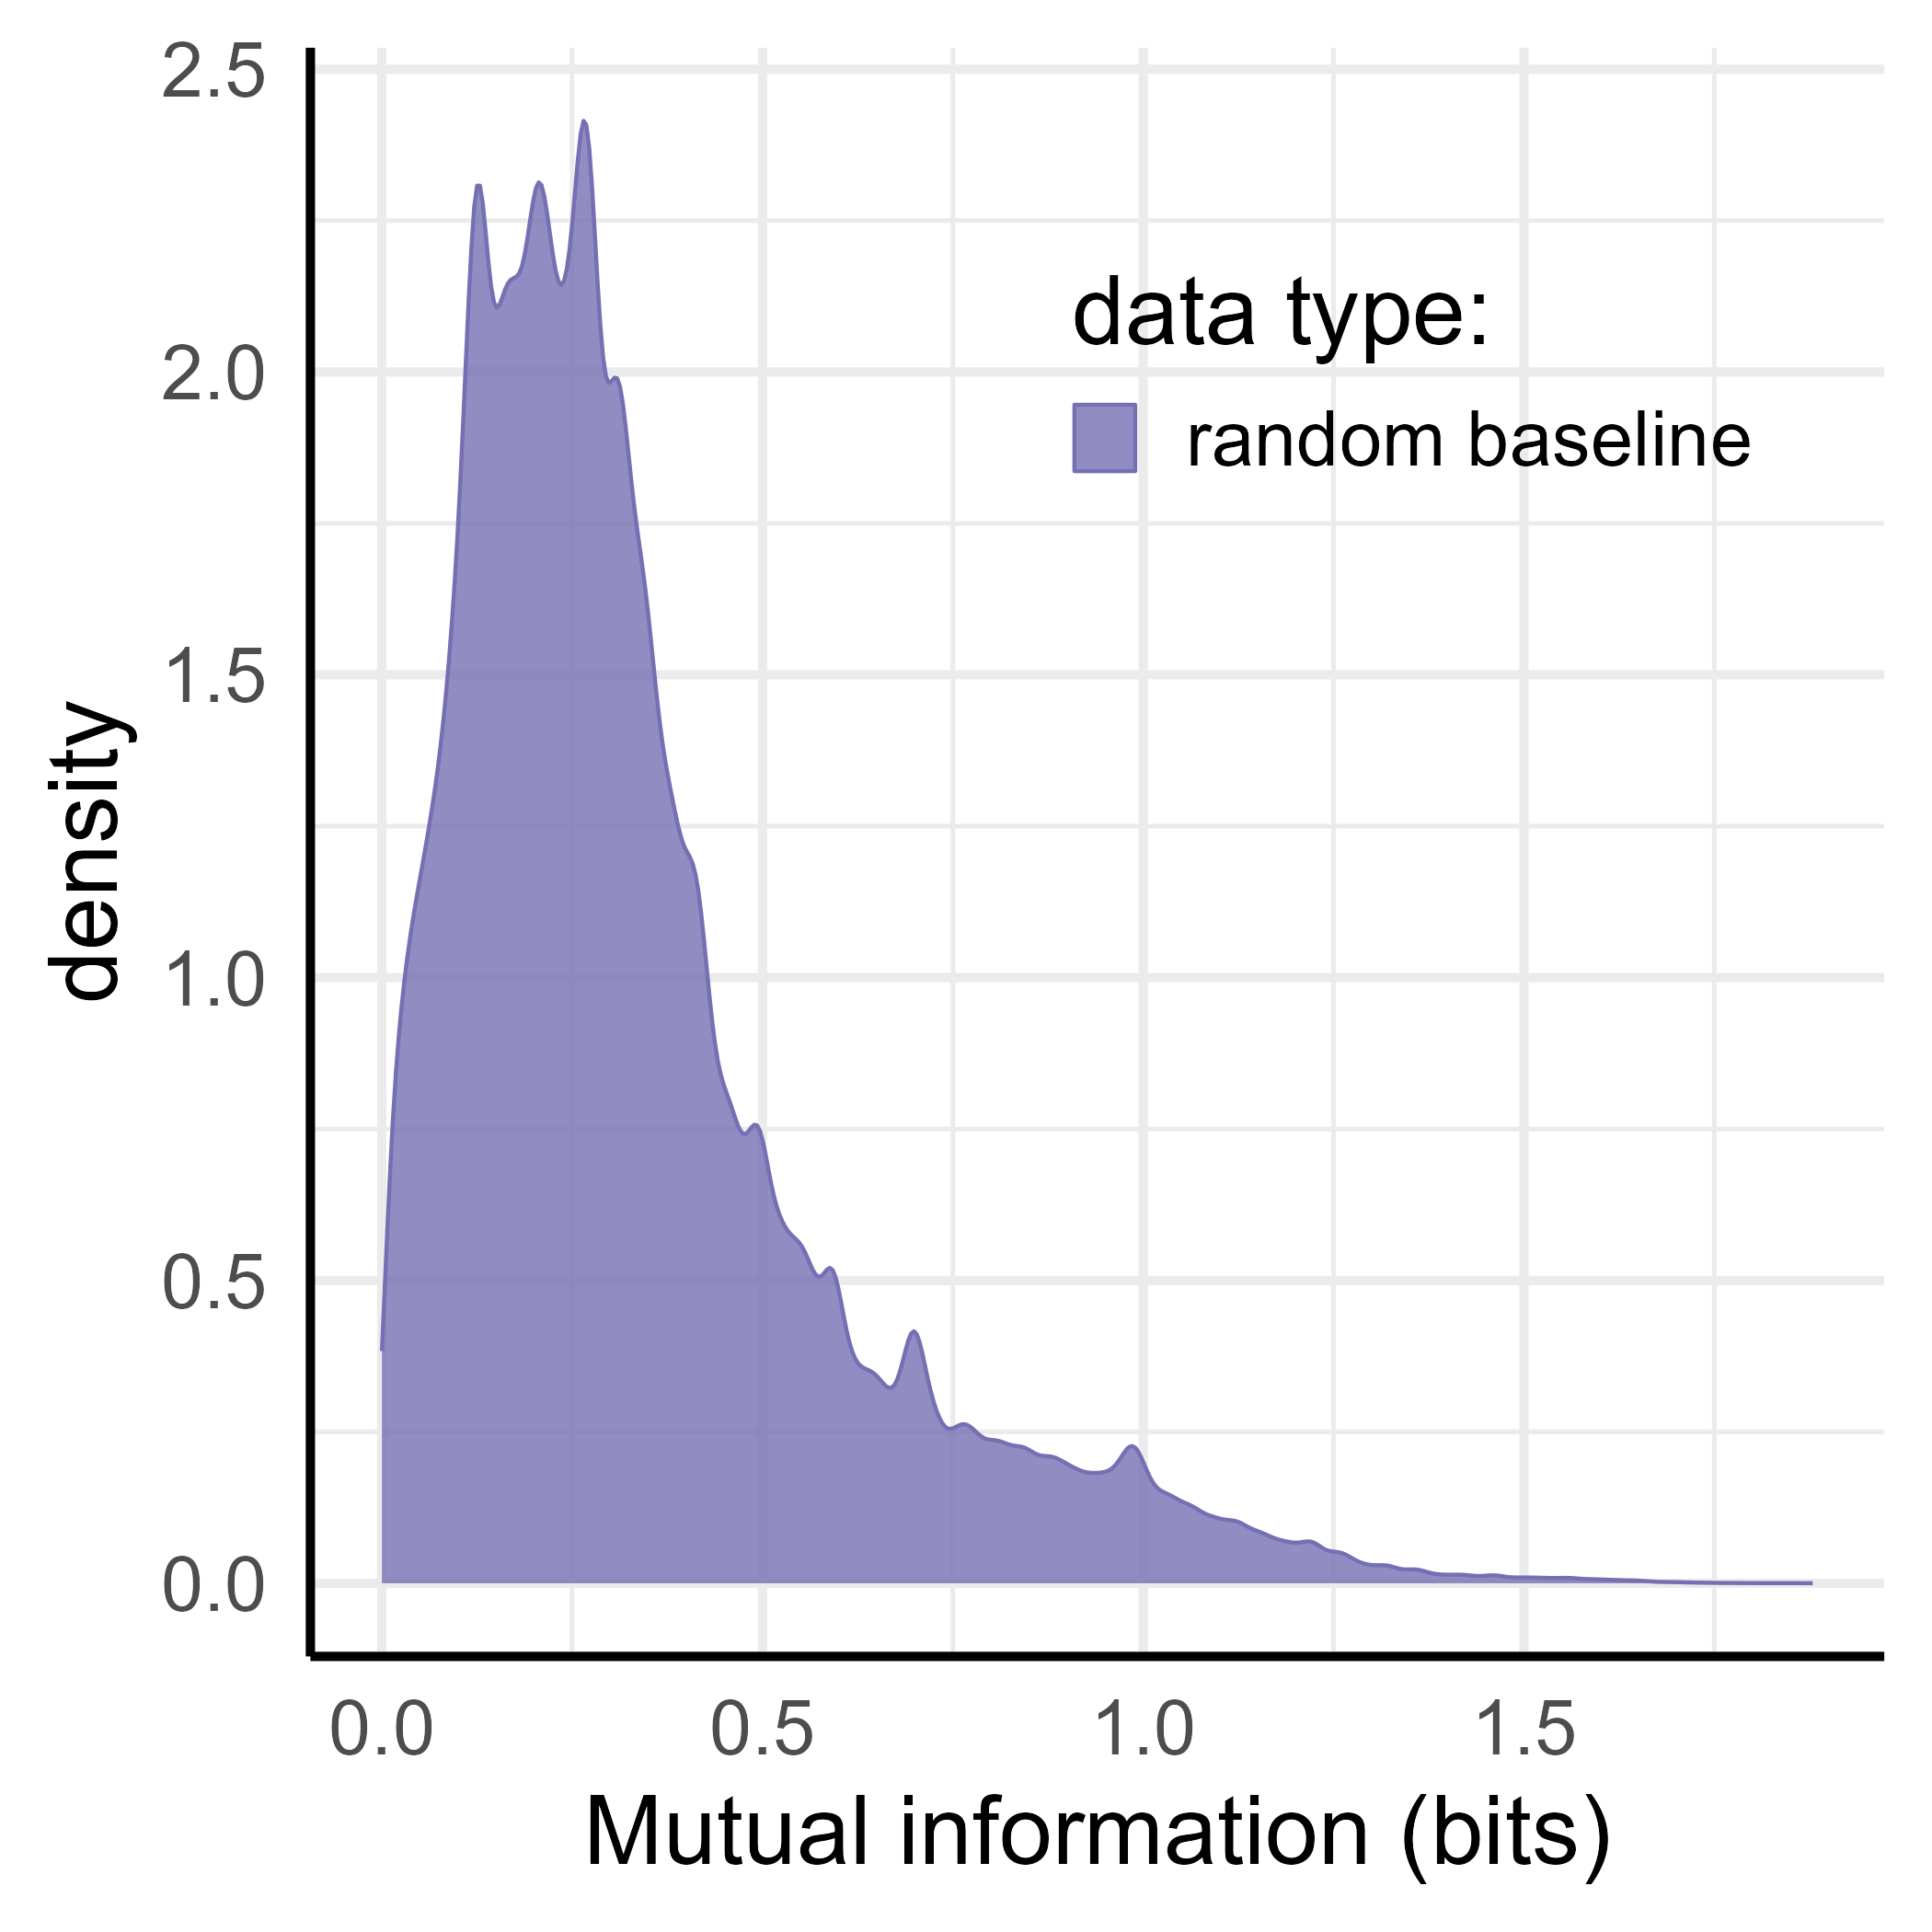
Natural languages will have more predictive structure than chance.
low
predictive structure
high
predictive structure
Maisy Hallam ・ Centre for Language Evolution・EvoLang 2024
Notes:
This is the mutual information of our random baselines across all languages. As you can see it tends quite low, indicating that we wouldn’t expect particularly good predictive structure to emerge by chance.

Slide 24
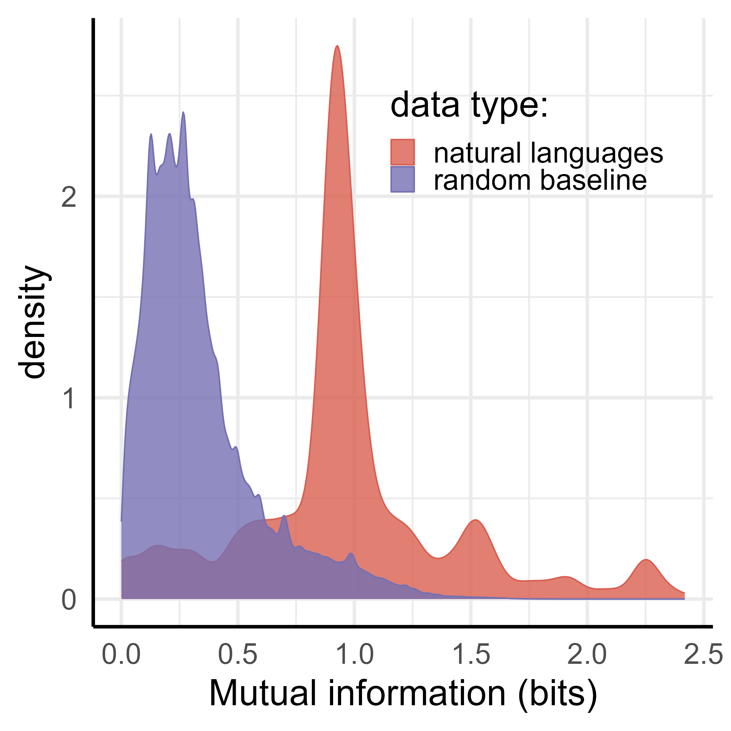
Natural languages will have more predictive structure than chance.
low
predictive structure
high
predictive structure
Maisy Hallam ・ Centre for Language Evolution・EvoLang 2024
Notes:
And if we compare our natural languages, we now see that the predictive structure of languages is substantially greater than the random baseline! Indicating that predictive structure is indeed a design feature and didn’t emerge by chance. We can do better than this:

Slide 25
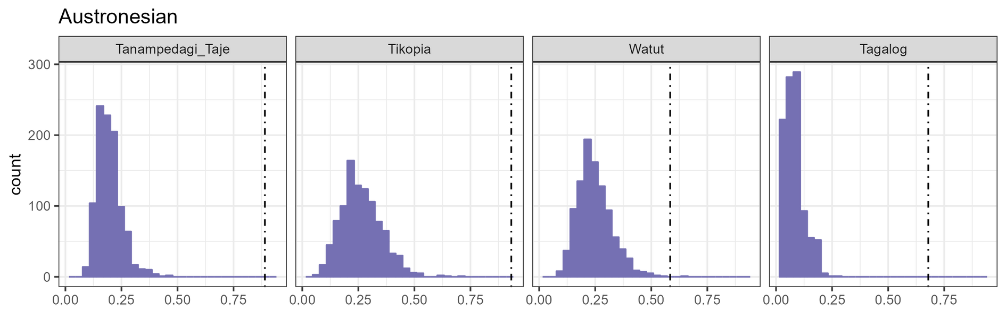
Natural languages will have more predictive structure than chance.
Maisy Hallam ・ Centre for Language Evolution・EvoLang 2024
Notes:
Here’s Austronesian – same deal, the distribution is the simulations, and the dotted line is our natural language. In all cases the natural language’s predictive structure is way higher than its simulated counterparts

Slide 26
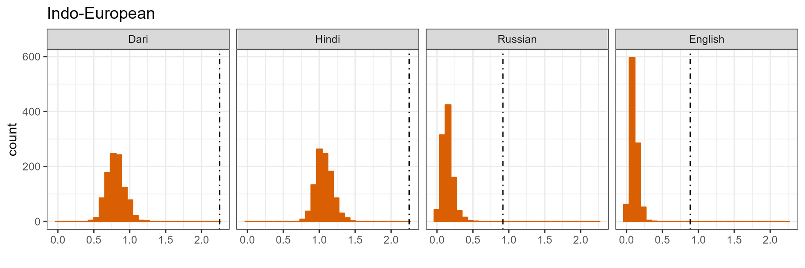
Natural languages will have more predictive structure than chance.
Maisy Hallam ・ Centre for Language Evolution・EvoLang 2024
Notes:
And for IE

Slide 27
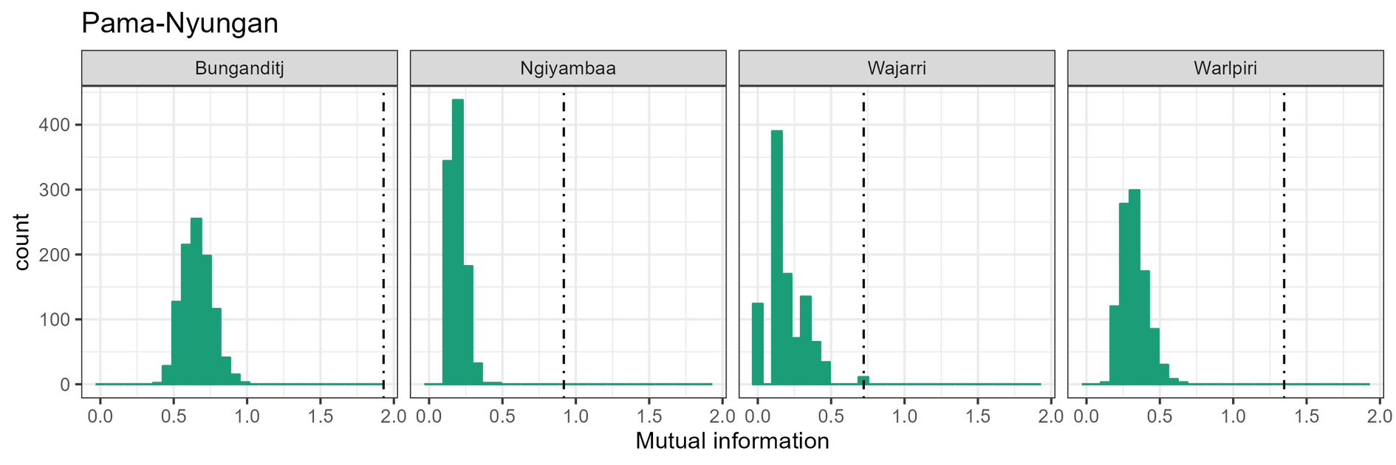
Natural languages will have more predictive structure than chance.
Maisy Hallam ・ Centre for Language Evolution・EvoLang 2024
Notes:
And for PN

Slide 28
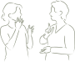

Questions
are there cross-linguistic patterns in how kin are categorised together?
...and how do we as individuals determine which kin should be categorised together?
Maisy Hallam ・ Centre for Language Evolution・EvoLang 2024
Notes:
So to answer that first question – yes, we have found a crosslinguistic pattern. We have evidence of underlying structure despite surface level variation
The need for predictive structure places limits on the kinds of categories that can exist in a system simultaneously (hence constrained variation)
but what events led to this constrained crosslinguistic distribution? do humans really like systematic predictability?

Slide 29
Do people prefer to categorise kin in a way that increases predictive structure?
Maisy Hallam ・ Centre for Language Evolution・EvoLang 2024
Notes:
in other words, do they use the meanings of terms they already know to infer what categories new people must be in?
Do they care if sometimes the child of a 'funcle’ is a brother and sometimes a cousin? Do they generalise kin in a way that increases predictive structure?
I ran an experiment to test this.

Slide 30
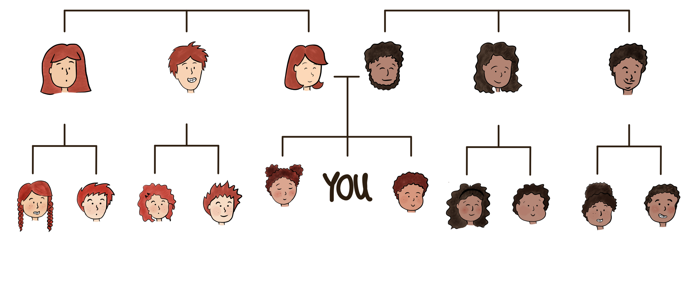
øqoç
øqoç
aqinudød
orinoçim
emøyeç
emøyeç
ømenad
ømenad
iqur
uquçun
Maisy Hallam ・ Centre for Language Evolution・EvoLang 2024
Notes:
Participants were shown family trees labelled with artificial kinship terms, with some kin left unlabelled. Their task was to use the information they were given to generalise the remaining terms to new kin.

Slide 31
øqoç
øqoç
aqinudød
orinoçim
emøyeç
emøyeç
ømenad
ømenad
iqur
uquçun
In this language, what would you call your mother’s brother’s son?
UNDO
iqur
uquçun
adeçim
aweh
DONE
Maisy Hallam ・ Centre for Language Evolution・EvoLang 2024

Slide 32
øqoç
øqoç
aqinudød
orinoçim
emøyeç
emøyeç
ømenad
ømenad
iqur
iqur
uquçun
In this language, what would you call your mother’s brother’s son?
UNDO
iqur
uquçun
adeçim
aweh
DONE
Maisy Hallam ・ Centre for Language Evolution・EvoLang 2024

Slide 33
øqoç
øqoç
aqinudød
orinoçim
emøyeç
emøyeç
ømenad
ømenad
iqur
iqur
uquçun
In this language, what would you call your mother’s sister’s daughter?
UNDO
iqur
uquçun
adeçim
aweh
DONE
Maisy Hallam ・ Centre for Language Evolution・EvoLang 2024

Slide 34
øqoç
øqoç
aqinudød
orinoçim
emøyeç
emøyeç
ømenad
ømenad
iqur
iqur
iqur
uquçun
In this language, what would you call your mother’s sister’s daughter?
UNDO
iqur
uquçun
adeçim
aweh
DONE
Maisy Hallam ・ Centre for Language Evolution・EvoLang 2024

Slide 35
øqoç
øqoç
aqinudød
orinoçim
emøyeç
emøyeç
ømenad
ømenad
iqur
iqur
iqur
uquçun
In this language, what would you call your father’s brother’s daughter?
UNDO
iqur
uquçun
adeçim
aweh
DONE
Maisy Hallam ・ Centre for Language Evolution・EvoLang 2024

Slide 36
øqoç
øqoç
aqinudød
orinoçim
emøyeç
emøyeç
ømenad
ømenad
iqur
iqur
iqur
uquçun
uquçun
In this language, what would you call your father’s brother’s daughter?
UNDO
iqur
uquçun
adeçim
aweh
DONE
Maisy Hallam ・ Centre for Language Evolution・EvoLang 2024

Slide 37
øqoç
øqoç
aqinudød
orinoçim
emøyeç
emøyeç
ømenad
ømenad
iqur
iqur
iqur
uquçun
uquçun
In this language, what would you call your father’s sister’s daughter?
UNDO
iqur
uquçun
adeçim
aweh
DONE
Maisy Hallam ・ Centre for Language Evolution・EvoLang 2024

Slide 38
øqoç
øqoç
aqinudød
orinoçim
emøyeç
emøyeç
ømenad
ømenad
iqur
iqur
iqur
uquçun
uquçun
uquçun
In this language, what would you call your father’s sister’s daughter?
UNDO
iqur
uquçun
adeçim
aweh
DONE
Maisy Hallam ・ Centre for Language Evolution・EvoLang 2024

Slide 39
øqoç
øqoç
aqinudød
orinoçim
emøyeç
emøyeç
ømenad
ømenad
iqur
iqur
iqur
uquçun
uquçun
uquçun
In this language, what would you call your mother’s brother’s daughter?
UNDO
iqur
uquçun
adeçim
aweh
DONE
Maisy Hallam ・ Centre for Language Evolution・EvoLang 2024

Slide 40
øqoç
øqoç
aqinudød
orinoçim
emøyeç
emøyeç
ømenad
ømenad
iqur
iqur
iqur
iqur
uquçun
uquçun
uquçun
In this language, what would you call your mother’s brother’s daughter?
UNDO
iqur
uquçun
adeçim
aweh
DONE
Maisy Hallam ・ Centre for Language Evolution・EvoLang 2024

Slide 41
øqoç
øqoç
aqinudød
orinoçim
emøyeç
emøyeç
ømenad
ømenad
iqur
iqur
iqur
iqur
uquçun
uquçun
uquçun
In this language, what would you call your father’s brother’s son?
UNDO
iqur
uquçun
adeçim
aweh
DONE
Maisy Hallam ・ Centre for Language Evolution・EvoLang 2024

Slide 42
øqoç
øqoç
aqinudød
orinoçim
emøyeç
emøyeç
ømenad
ømenad
iqur
iqur
iqur
iqur
uquçun
uquçun
uquçun
uquçun
Are you happy with your selection? Press Done to continue or Undo to go back.
UNDO
iqur
uquçun
adeçim
aweh
DONE
Maisy Hallam ・ Centre for Language Evolution・EvoLang 2024

Slide 43

2x2
aunt
aunt
uncle
uncle
Maisy Hallam ・ Centre for Language Evolution・EvoLang 2024
Notes:
Each participant does that process eight times. Each time, they are given different terms in a different orientation.
We are expecting that they will group together people whose parents share a kin term.
Judging from some pilot versions of this study, we expect they might also like to make a gender distinction between boys and girls.
And as we just saw they can have it both ways.

Slide 44
2x2
aunt
aunt
uncle
uncle
aunt
uncle
uncle
aunt
aunt
uncle
aunt
uncle
Maisy Hallam ・ Centre for Language Evolution・EvoLang 2024
Notes:
Each participant does that process eight times. Each time, they are given different terms in a different orientation.
We are expecting that they will group together people whose parents share a kin term.
Judging from some pilot versions of this study, we expect they might also like to make a gender distinction between boys and girls.
And as we just saw they can have it both ways.

Slide 45
1x4
2x2
nuncle
nuncle
nuncle
nuncle
aunt
aunt
uncle
uncle
aunt
uncle
uncle
aunt
aunt
uncle
aunt
uncle
Maisy Hallam ・ Centre for Language Evolution・EvoLang 2024
Notes:
Each participant does that process eight times. Each time, they are given different terms in a different orientation.
We are expecting that they will group together people whose parents share a kin term.
Judging from some pilot versions of this study, we expect they might also like to make a gender distinction between boys and girls.
And as we just saw they can have it both ways.

Slide 46
1
2-2
3-1
nuncle
nuncle
nuncle
nuncle
aunt
aunt
uncle
uncle
aunt
nuncle
nuncle
nuncle
aunt
uncle
uncle
aunt
nuncle
aunt
nuncle
nuncle
aunt
uncle
aunt
uncle
nuncle
nuncle
aunt
nuncle
nuncle
nuncle
nuncle
aunt
Maisy Hallam ・ Centre for Language Evolution・EvoLang 2024
Notes:
Each participant does that process eight times. Each time, they are given different terms in a different orientation.
We are expecting that they will group together people whose parents share a kin term.
Judging from some pilot versions of this study, we expect they might also like to make a gender distinction between boys and girls.
And as we just saw they can have it both ways.

Slide 47
Participants will extend a category on the basis of predictive structure.
Maisy Hallam ・ Centre for Language Evolution・EvoLang 2024

Slide 48
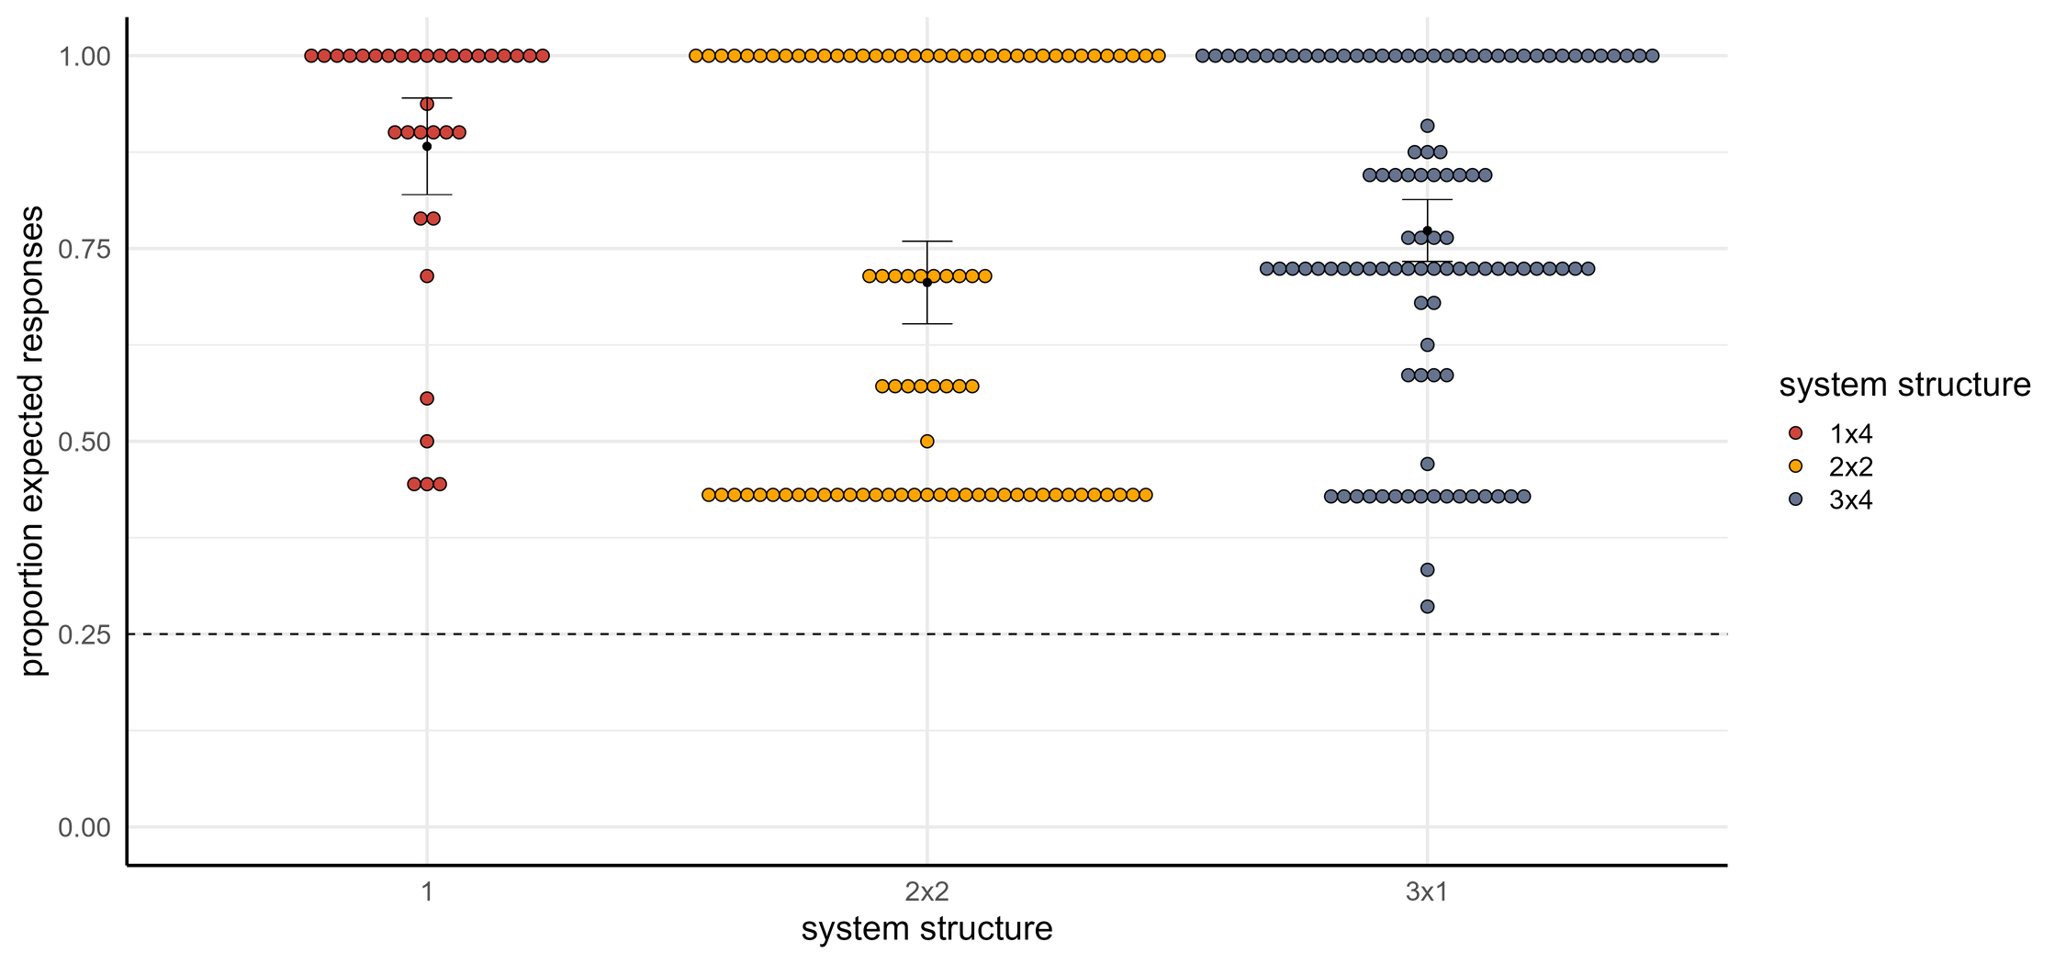
Participants will extend a category on the basis of predictive structure.
Maisy Hallam ・ Centre for Language Evolution・EvoLang 2024
Notes:
plot of accuracy

Slide 49
H1: People will extend a kin category on the basis of predictive structure.
Maisy Hallam ・ Centre for Language Evolution・EvoLang 2024
Notes:
plot of accuracy

Slide 50
H1: People will extend a kin category on the basis of predictive structure.
Maisy Hallam ・ Centre for Language Evolution・EvoLang 2024
Notes:
plot of accuracy

Slide 51
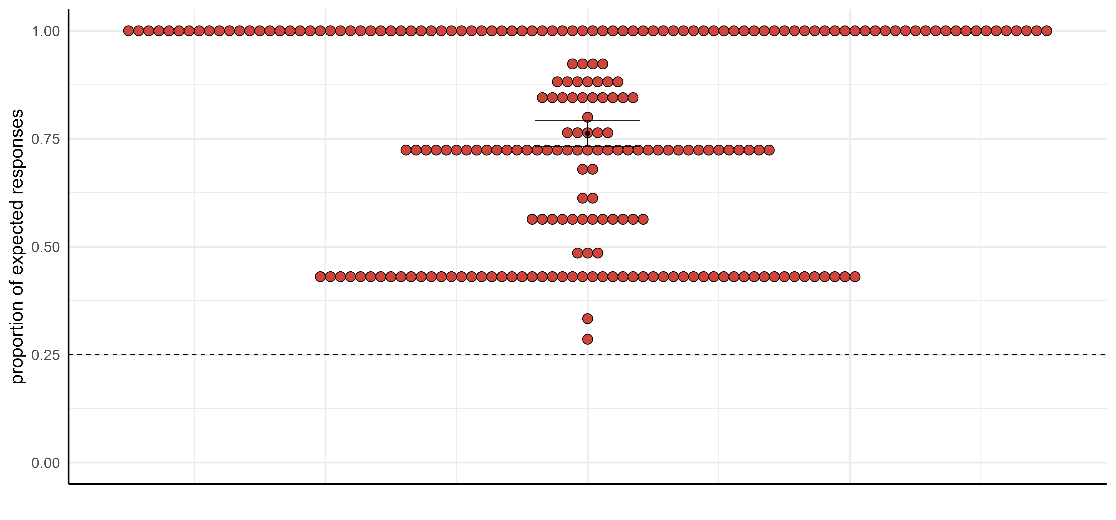
Participants will extend a category on the basis of predictive structure.
Maisy Hallam ・ Centre for Language Evolution・EvoLang 2024
Notes:
plot of accuracy

Slide 52
Participants will extend a category on the basis of predictive structure.
Maisy Hallam ・ Centre for Language Evolution・EvoLang 2024
Notes:
We get a lot of participants giving us exactly the answers we expect, which maximise predictive structure. But we also have large groups around 0.7 and 0.4 who aren’t giving expected responses – what are they doing?

Slide 53
øqoç
øqoç
aqinudød
orinoçim
emøyeç
emøyeç
ømenad
ømenad
iqur
iqur
iqur
iqur
uquçun
uquçun
uquçun
uquçun
Participants group kin on the basis of predictive structure…
Maisy Hallam ・ Centre for Language Evolution・EvoLang 2024
Notes:
There are a few ways to solve the experimental paradigm. They could do this, which is what we expect.

Slide 54
øqoç
øqoç
aqinudød
orinoçim
emøyeç
emøyeç
ømenad
ømenad
aweh
iqur
aweh
iqur
aweh
iqur
aweh
iqur
…and sometimes on the basis of shared gender.
Maisy Hallam ・ Centre for Language Evolution・EvoLang 2024
Notes:
They could group people by gender – one term for boys and one for girls.

Slide 55
øqoç
øqoç
aqinudød
orinoçim
emøyeç
emøyeç
ømenad
ømenad
aweh
iqur
aweh
iqur
adeçim
uquçun
adeçim
uquçun
And sometimes both predictive structure and gender!
Maisy Hallam ・ Centre for Language Evolution・EvoLang 2024
Notes:
Or they could do both! This is also consistent with our hypothesis.

Slide 56
Summary
kinship systems have
strong predictive structure that constrains their variation
and one way people prefer to categorise kin is by increasing predictive structure
Maisy Hallam ・ Centre for Language Evolution・EvoLang 2024
Notes:
To conclude!
at the beginning i shared two questions.
first, what shared patterns or universals do kinship systems have across the world's languages.
we found that they have much stronger predictive structure than you would expect to have arisen by chance. this constrains their variation by limiting the way that kin terms can vary within languages, but still allows for lots of surface variation.
second - if it's not chance, how do humans give rise to this typological tendency?
we found that when asked to categorise new family members into existing or new categories, people would not do so randomly, but systematically. they liked to group together people with visual salient similarities like gender, but within the confines of predictive structure.

Slide 57
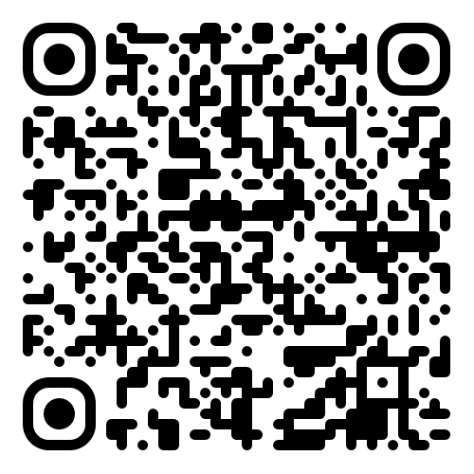
Thanks!
Maisy Hallam
http://maisyhallam.github.io/
maisy.hallam@ed.ac.uk
Give the experiment a go!

Slide 58
Appendix: How else do participants categorise kin?
øqoç
øqoç
aqinudød
orinoçim
emøyeç
emøyeç
ømenad
ømenad
iqur
iqur
iqur
iqur
uquçun
uquçun
uquçun
uquçun
Maisy Hallam ・ Centre for Language Evolution・EvoLang 2024
Notes:
Let’s imagine our participants gave our hypothetical perfect answer, like this, where child terms are perfectly predictable from parent terms…

Slide 59
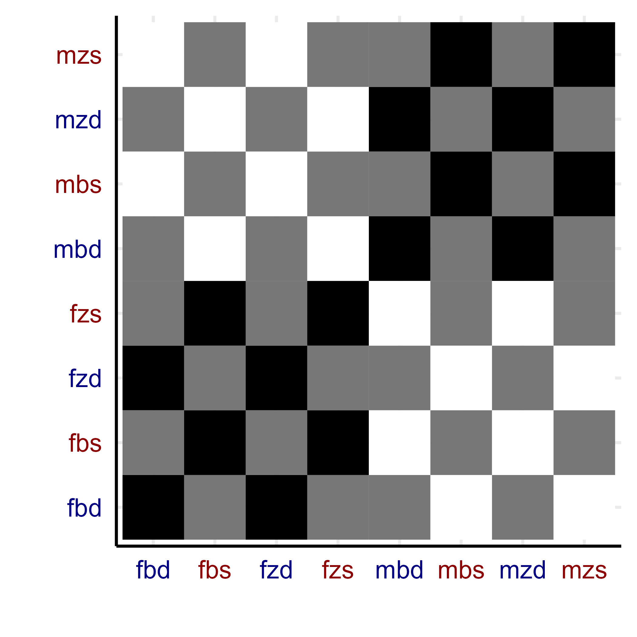
Appendix: How else do participants categorise kin?
expectations
reality
mother’s sister’s son
mother’s sister’s daughter
mother’s brother’s son
mother’s brother’s daughter
father’s sister’s son
father’s sister’s daughter
father’s brother’s son
father’s brother’s daughter
fa bro dau
fa bro son
fa sis dau
fa sis son
mo bro dau
mo bro son
mo sis dau
mo sis son
Maisy Hallam ・ Centre for Language Evolution・EvoLang 2024
Notes:
Where each cell represents how often two kin were categorised together. Each axis lists each relative. We’d expect all mother’s sibling’s children to be categorised together, and all father’s sibling’s children to be categorised together, giving us these large black quadrants. Conversely, we’d expect people not to mix and match – the white quadrants.

Slide 60
Appendix: How else do participants categorise kin?
expectations
reality
mother’s sister’s son
mother’s sister’s daughter
mother’s brother’s son
mother’s brother’s daughter
father’s sister’s son
father’s sister’s daughter
father’s brother’s son
father’s brother’s daughter
fa bro dau
fa bro son
fa sis dau
fa sis son
mo bro dau
mo bro son
mo sis dau
mo sis son
Maisy Hallam ・ Centre for Language Evolution・EvoLang 2024
Notes:
But the reality is a little different. We do still get darker patches where we expect them, but our white quadrants are not perfect white. We’re getting this checkboard effect – because the axes alternate boy-girl, this indicates a preference for people to divide by gender. They really like to do this, even if it means ignoring the predictive structure cues. They do sometimes attune to the cues, but not always.

Slide 61
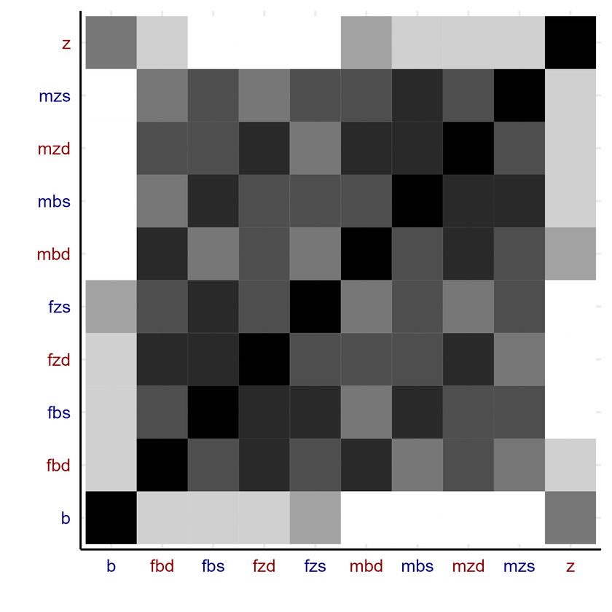
Appendix: How else do participants categorise kin?
expectations
reality
Maisy Hallam ・ Centre for Language Evolution・EvoLang 2024
Notes:
heatmaps

Slide 62
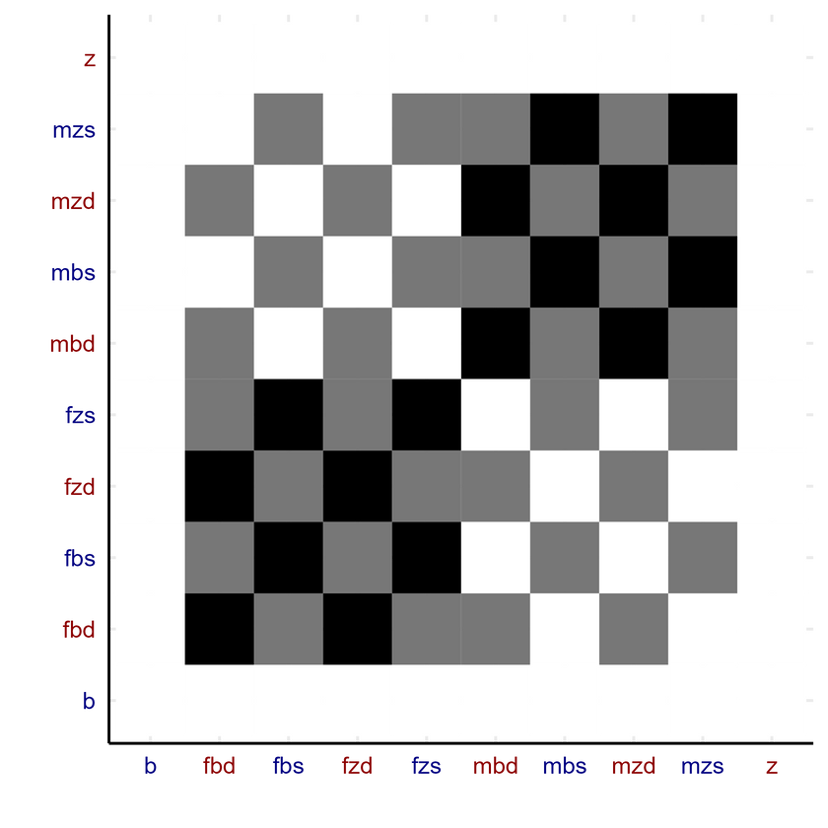
E1: What other strategies are viable for extending a kin category?
2x2
expectations
reality
Maisy Hallam ・ Centre for Language Evolution・EvoLang 2024
Notes:
heatmaps

Slide 63
How else do participants categorise kin?
expectations
reality
Maisy Hallam ・ Centre for Language Evolution・EvoLang 2024
Notes:
If all our participants behaved properly, we would expect something like this….

Slide 64
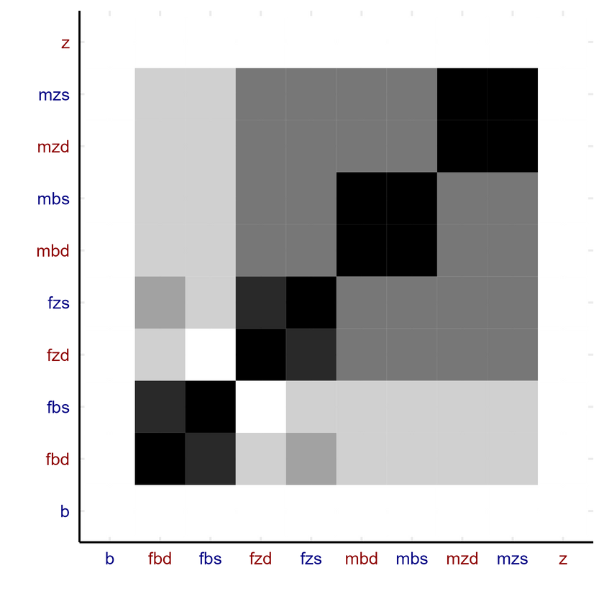
How else do participants categorise kin?
3x1
expectations
reality
Maisy Hallam ・ Centre for Language Evolution・EvoLang 2024
Notes:
heatmaps

Slide 65
How else do participants categorise kin?
3x1
expectations
reality
Maisy Hallam ・ Centre for Language Evolution・EvoLang 2024
Notes:
heatmaps

Slide 66
Notes:
Include the simulation animation here

Slide 67
Notes:
Morphology question – I am thinking of doing this next. I was inspired because a lot of the kinship systems I use as classic examples of high predictive structure are compositional – Hawaiian is one of them. I’d expect that this encourages more predictive structure regularisation as opposed to other methods. Though theoretically you could have predictive structure morphology + gender morphology. Or just gender, like Spanish.

